Slide 1
Global Covid Analytics
By Tableau & SQL

Slide 2
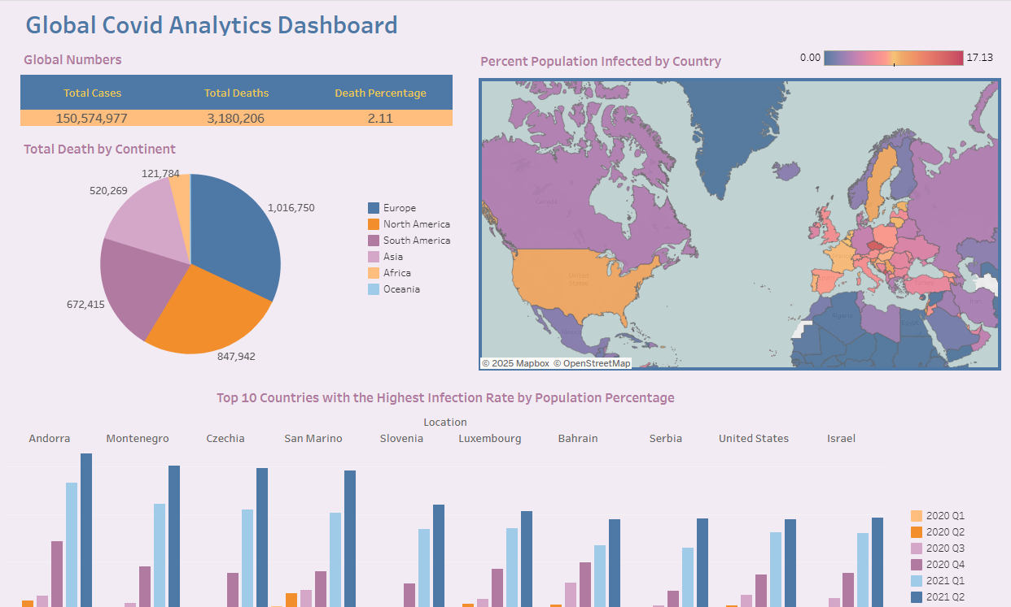

Slide 3
Project Description
This Tableau Global COVID Analytics Dashboard provides a comprehensive analysis of the pandemic’s global impact. It is a powerful tool for understanding COVID-19’s global impact, facilitating data-driven public health strategies. It enables policymakers, researchers, and analysts to track trends, assess regional disparities, and make data-driven decisions.

Slide 4
Key Metrics Tracked:
Total Cases – Cumulative confirmed COVID-19 cases globally.
Total Deaths – Number of reported deaths due to COVID-19.
Death Percentage – Mortality rate based on confirmed cases.
Total Deaths by Continent – Breakdown of fatalities across major regions.
Percent Population Infected by Country – Infection rates relative to the total population.
Top 10 Countries with the Highest Infection Rate – Identifies the most affected countries over time.

Slide 5
Key Features:
Global Overview Panel – Displays total cases, deaths, and mortality rate in a structured format.
Interactive Heat Map – Visualizes the infection rate by country for easy regional comparison.
Death Distribution by Continent – A pie chart representing COVID-19 fatalities by continent.
Time-Series Analysis – Tracks infection rates across multiple quarters to identify trends.
Country-Level Deep Dive – Highlights the highest infection rates relative to population.

Slide 6
Insights & Findings
Global Impact – Over 150 million reported cases and 3.18 million deaths, with a 2.11% mortality rate.
Regional Disparities – Europe and North America show the highest fatality numbers, followed by South America and Asia.
Infection Hotspots – Countries like Andorra, Montenegro, Czechia, and San Marino show the highest infection rates.
Quarterly Trends – Infection rates peaked in specific quarters, reflecting policy changes, lockdowns, and vaccination efforts.

Slide 7
Use Cases
Policy Decision-Making – Governments can use insights to evaluate past interventions and plan future strategies.
Public Awareness – Offers an interactive way for individuals to understand COVID-19 trends in their region.
Healthcare Resource Allocation – Helps organizations identify high-risk areas requiring urgent medical support.

Slide 8
Recommendations
Vaccination & Prevention – High-risk countries should strengthen vaccination campaigns and preventive measures.
Healthcare System Readiness – Authorities should assess healthcare capacity based on mortality rate trends.
Data Transparency & Reporting – More granular data can enhance global understanding and response strategies.

Slide 9
Technical Details Summary
Data Source: Excel CSV files (COVID-19 cases, deaths, population data).
Database & Querying: SQL (cleaning, transforming, and creating database views for analysis).
Visualization Tool: Tableau (interactive dashboards, geographic maps, trend analysis).
Data Processing:
Used SQL to clean, transform, and aggregate data.
Created SQL queries and saved them as views for efficient data retrieval.
Structured data in a way that allowed seamless integration with Tableau.
Visualization Tool: Tableau for interactive data representation and insights.

Slide 10
Thank you
Marwah Al-Badran
Cell: 469-536-2644
Email: Marwah.albadran@gmail.com
Githup: https://github.com/Marwah-88/Sales-Performance-Dashboard/edit/main/README.md

